Slide 1

City of West Burlington
Budget Presentation
Fiscal Year 2024-2025
Gregg Mandsager, City Administrator
Angela Moore, Finance Manager

Slide 2
Introduction
The proposed budget:
Tackles the challenges to property taxes created by HF 718 and takes into account our new taxable valuations,
HF 718 does not allow the City to address two years of negative growth county wide,
Continues to address capital project and equipment needs in coordination with capital improvement/equipment planning,
Maintains service levels, and
Maintains a strong General Fund Balance.

Slide 3
Changes to the Budget as Proposed
Levy Rate: FY 2023/2024 $10.00, FY 2024/2025 $10.10. This .10 increase generates $17,698.
Franchise Fees: Franchise Fee being added to existing Franchise Agreement (Gas and Electric). A Franchise Fee of 3% (2% increase on overall revenues) has been included in the budget with a revenue purposed statement dedicating its use to sanitary sewers and water main projects.
Transfer $200,000 from the general fund to a capital account (similar to our process for capital equipment) for Capital Projects, including sanitary sewer and watermain projects.
Discussed removal of the $1 capital project fee on monthly water bills. No consensus to date. This generates over $22,000 versus the $17,698 (.10)

Slide 4
Tax Rate History
The proposed 2024/25 budget reflects a proposed tax rate of $10.10/$1,000 of taxable property valuation.
2010/11 9.86
2011/12 9.80
2012/13 9.80
2013/14 9.75
2014/15 10.10
2015/16 10.10
2016/17 10.00
2017/18 10.00
2018/19 10.00
2019/20 10.00
2020/21 10.00
2021/22 9.65
2022/23 10.00
2023/24 10.00

Slide 5
General Fund Balance
The proposed budget decreases the General Fund Balance from 25.38% to 21.22%. Bringing the GF to $754,350.49 v. $954,350.49.
The budget designates $200,000 in a one-time transfer for watermain projects in FY 2024-2025
Having a strong General Fund balance and a Fund Balance Policy in place will allow time for staff and City Council to plan for how to address revenue reductions or emergencies should they occur.
*Note: While the City has yet to adopt a formal policy related to the General Fund Balance, 25% (or more) is a good target with only emergency and one-time expenditures reducing that fund balance. A General Fund Balance Policy typically provides that except for extraordinary circumstances, unassigned fund balance should not be used to fund any portion of ongoing and routine operating expenditures of the City. Extraordinary circumstances can include significant revenue fluctuations (i.e., State legislative changes limiting property). In the event that the use of an unassigned fund balance is necessary to provide a short-term solution to maintaining essential services, the City can evaluate current and future economic conditions to evaluate the extent of expenditure reductions or revenue increases that would be needed to achieve day-to-day financial stability and restore the fund balance.

Slide 6
Fund Balance Comparison
Fund FY 21/22 FY 22/23 FY 23/24 FY 24/25
General Fund $502,685.38 $847,735.71 $782,508.68 $754,350.49
Hotel/Motel $68,615.38 $146,147.53 $147,722.00 $129,188.19
RUTF $116,512.30 $135,829.16 $55,049.16 $8,409.44
LOST $301,015.37 $513,058.42 $744,856.56 $579,772.56
Water $96,499.65 $354,171.89 $1,295,054.91 $43,192.22
Sewer $288,308.99 $95,193.68 $30,115.39 $217,240.93**
*Water: Internal Loan for Sewer Jet Vac, $418,192.22 net positive assuming paid off
*Sewer: Additional employee (registered apprenticeship program), Jet-Vac, Force Main repairs, Contracted jetting prior to Jet Vac purchase, 24” Force Main Study

Slide 7
Property Valuations
Actual Valuations (100%) ***Valuations updated in February 2023
FY 2021/21 $308,287,791
FY 2022/23 $312,315,259
FY 2023/24 $313,186,360
FY 2024/25 $382,556,691 (an increase of $56,841,671)
Taxable Valuations ***Valuations updated in February 2023
Increased from a total of $206,882,486 to $234,246,841 (an increase of $27,364,355
Residential Rollback went from 54.6501% compared to 46.3428%. Residential valuations decreased by $6,081,863. Nearly twice the decrease from last FY $3,467,977
Commercial Property remained at the 90% rollback. Commercial valuations increased $31,688,201*
Industrial property remained at the 90% rollback. Industrial valuations decreased by $217,134*
Note: At the League’s Advanced Budget Session it was mentioned that the $8.10 per $1,000 was first introduced in 1975. That number, adjusted for inflation, would be $46.32 today.
Note: New in FY 2023/24 year is an automatic Business Property Tax Credit that makes the first $150,000 of taxable valuation for commercial, industrial and railroad subject to the residential rollback of $56.4919 before applying the 90% rollback. The State is providing a rollback for a limited time.
Notes:
Actual Valuations are 100% Valuation Military Exemptions Deducted
Taxable Valuation. Taxable Valuations Commercial Property: FY22/23 115,197,549 FY23/24 290,501,160-183,036,668(hospital)=107464,492

Slide 8
100% and Taxable Valuation Comparison

Slide 9
Tax Levy
Tax Rate FY 23/24 FY 24/25
General Levy (maximum) 8.10 7.94118
Liability (Insurance) Levy .95888 .74821
FICA/IPERS .42884 .64800
Employee Benefits Levy is at .22871 .61965
Debt Service Levy .29137 .14319
Emergency Levy .00000 .00000
The new general fund levy following Property Tax Legislation is $7.94118.
Total Proposed Levy $10.10
Property Tax Revenue (10.10): FY 23/24 = $1,708,292, FY 24/25 = $1,898,909

Slide 10
Budget Issues and Challenges
For Fiscal Years 2022-2030, the annual reduction in backfill (property taxes) for the City of West Burlington will be as follows (estimated amount distributed to the city until phased out in 2030):
2022 $111,430.59
2023 $97,501.76
2024 $83,572.94 (Revised $80,031)
2025 $69,644.12
2026 $55,715.29
2027 $41,786.47
2028 $27,857.65
2029 $13,928.82
2030 $0.00

Slide 11
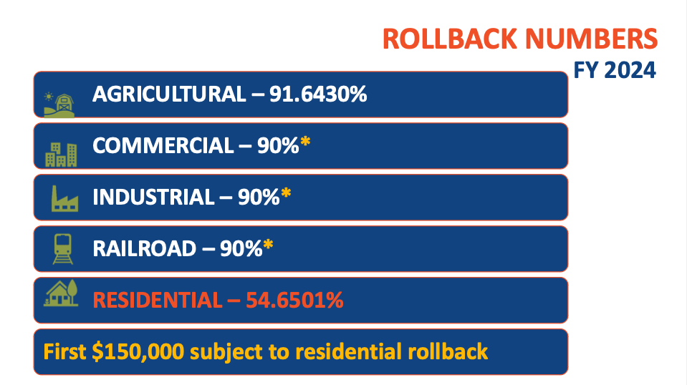
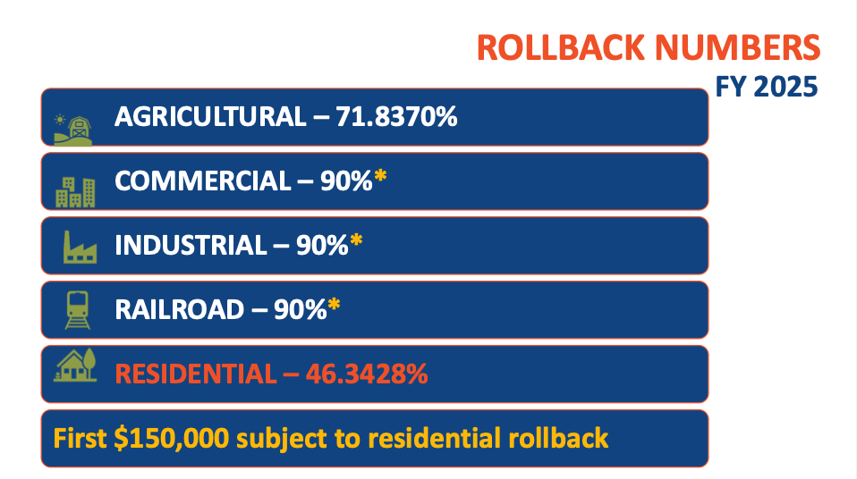
Roll Back
*Provided by the Iowa League of Cities

Slide 12
Budget Issues and Challenges
CPI
US CPI September 2022 8.2%, September 2023 3.7%
Midwest CPI September 2022 8.1%, September 2023 3.2%
Municipal Cost Index September 2022 9.14%, September 2023 1.42%
Rollback
2022 Residential 56.4094%
2023 Residential 54.1302%
2024 Residential 54.6501%
2025 Residential 46.3428% (8.3073% reduction)
2022 Multi-Res 67.50%
2023 Multi-Res 63.75% (2024 Same as residential)
2024 Multi-Res 54.6501% (Class eliminated, now using residential rate)
2025 Multi-Res 46.3428% (8.3073% reduction)

Slide 13
Budget Issues and Challenges
The residential rollback rate has seen a dramatic decrease for the coming fiscal year 8.3%!
Elimination of Multi-Res Property Class in FY 23/24
Business Property Tax Credit FY 23/24
Reduction in Backfill
CPI or Cost of Living (and other indexes)
Balancing our CIP needs and timing

Slide 14
Key Items
Capital Equipment 5-year Outlook and CIP provided.
The IT budget includes all computers others than squad cars.
Transfers were modified based on capital equipment and project needs.
The budget includes a 4% cost of living increase per contract for Public Works Employees, Police Officers and Non-Union Employees.
TIF Admin fees have been included as a transfer to support the general fund.
Wages for the city administrator, city clerk, finance staff, and IT are broken out 25% each in the general fund, water, sewer, and streets (plus TIF admin fee)
Health insurance is budgeted at a 4% increase; however, we need to consider setting aside additional funds for the medical self-insurance fund which was not been addressed when the City switched programs.
Property/Liability Insurance increased by 10.5%. We hope to see a reduction in work comp rates to offset this increase or explore new carriers (July 1 Start date).

Slide 15
Rate Adjustments
Pool admissions: $3 ages 0-3, $6 ages 3 plus, individual season pass $150, coupon books $54, Private Pool Parties $400, and swim lessons have been added at $60.00 for 8 lessons
Garbage Rates had been adjusted in prior FY to meet contract costs ($13.45 to $14.85). No change.
Recycling rates have been adjusted to reflect the increase in costs ($4.25 to $4.35)
Water Rates: FY 23/24 to FY 24/25 – No rate increase
Sewer Rates: FY 23/24 = $11.91, FY 24/25 $12.15, (This rate increase generates $29,622.33). Reminder: Sewer rates were adopted in 2023 for FY 23/24 and FY 24/25
DISCUSSION TOPIC: Going forward Speer Financial recommends a 2% annual rate increases every other year starting in FY 2024/25 for water and sewer to maintain sufficient revenues versus expenditures and to meet SRF requirements.
Start with sewer in FY 2024/25 (Reminder – look at fund balances as well)?
A 2% water rate increase would generate $34,075.53.

Slide 16
Property Taxes - Examples
$100,000 Home
2021/22 @ 9.65 rate and 56.4094% rollback = $544.35 in taxes
2022/23 @ 10.00 rate and 54.1302% rollback = $541.30 in taxes
2023/24 @ 10.00 rate and 54.6501% rollback = $546.50 in taxes
2024/25 @ 10.10 rate and 46.3428% rollback = $468.06 in taxes
$200,000 Home
2021/22 @ 9.65 rate and 56.4094% rollback = $1088.70 in taxes
2022/23 @ 10.00 rate and 54.1302% rollback = $1082.60 in taxes
2023/24 @ 10.00 rate and 54.6501% rollback = $1093.00 in taxes
2024/25 @ 10.10 rate and 46.3428% rollback = $936.12 in taxes
$100,000 Commercial
2021/22 @ 9.65 rate and 90% rollback = $868.50 in taxes
2022/23 @ 10.00 rate and 90% rollback = $900 in taxes
2023/24 @ 10.00 rate and 54.6501% rollback on first $150,000, 90% remainder = $564.92 in taxes
2024/25 @ 10.10 rate and 46.3428% rollback on first $150,000, 90% remainder = $468.06 in taxes
$200,000 Commercial
2021/22 @ 9.65 rate and 90% rollback = $1737 in taxes
2022/23 @ 10.00 rate and 90% rollback = $1800 in taxes
2023/24 @ 10.00 rate and 54.6501% rollback on first $150,000, 90% remainder = $1,269.75 in taxes
2024/25 @ 10.10 rate and 46.3428% rollback on first $150,000, 90% remainder = $1,156.59 in taxes
This is a significant reduction in property taxes over the past four years!
*County Auditor automatically adjusts for the new Commercial/Industrial Business Tax Credit, FY 24-25 has a bit of an anomaly with the assessed value changes and equalization order
Notes:
Updated 3/25

Slide 17
FY 2024-25 Proposed Budget Summary
The proposed 2024/25 budget is a balanced with budgeted revenues exceeding budgeted expenditures (after transfers).
Capital Projects: Gear Avenue Trail Phase 2, HMA Crack Filling, Water Main Replacement, and amendments to address any successful grants (Stormwater, Sanitary Sewer, etc.).
Capital Projects (Planning Stages): Stormwater, 24” Sewer Force main, Mt. Pleasant Street, water main annual replacement projects, sewer mains (clay tile replacement), CIP and more…
Maintaining existing levels of the services to the community and positioning the City to meet new challenges, and address capital project and equipment needs.
Future challenges could involve potential shortfalls in revenues from limited growth in taxable valuations and the new property tax legislation!
Major Discussion Items Included: Capital Projects, Levy Rate, Water& Sewer Rates and the Franchise Fee.

Slide 18
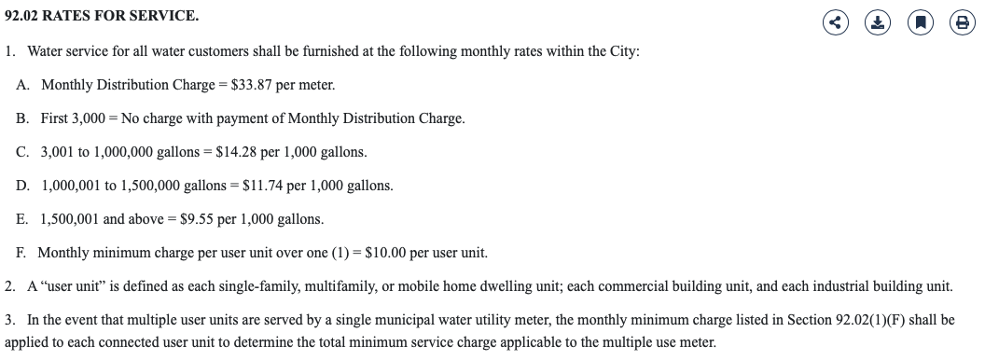
Supplemental Information
Water Rates

Slide 19
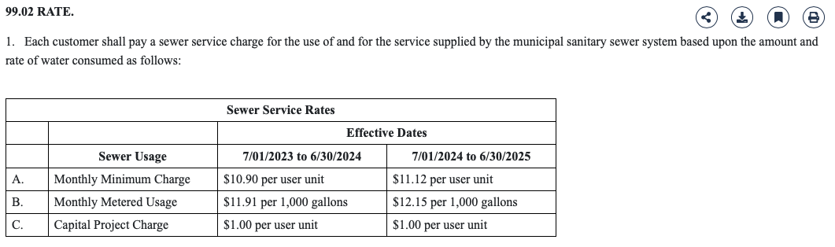
Supplemental Information
Sewer Rates

Slide 20
Supplemental Information
Alliant provided the following related to franchise fees:
Franchise fee estimates based on 2022 calendar year usage. These estimates are calculated down to the penny, but remember energy use, the weather and other factors can control these numbers. They are paid at the end of January, April, July and October. These fees are charged to all energy users, except the city. So any tax exempt business, group or school will have to pay the franchise fee.
Franchise fees and LOST are an “either or” on energy bills. With LOST, West Burlington currently gets $7.99 for every $100 it collects. With a franchise fee, the town would get to keep all of the revenue.
*Reminder that franchise fees apply to all users, including non-profits (hospital, church, etc.) and not simply property owners.
*Recommendation (original): That we at a minimum adopt a franchise fee ordinance and enter into an agreement even if the city chooses to leave the fee at 0%. Thereby allowing the City to modify the fee with 90 days notice to Alliant. (0% to 5%).

Slide 21
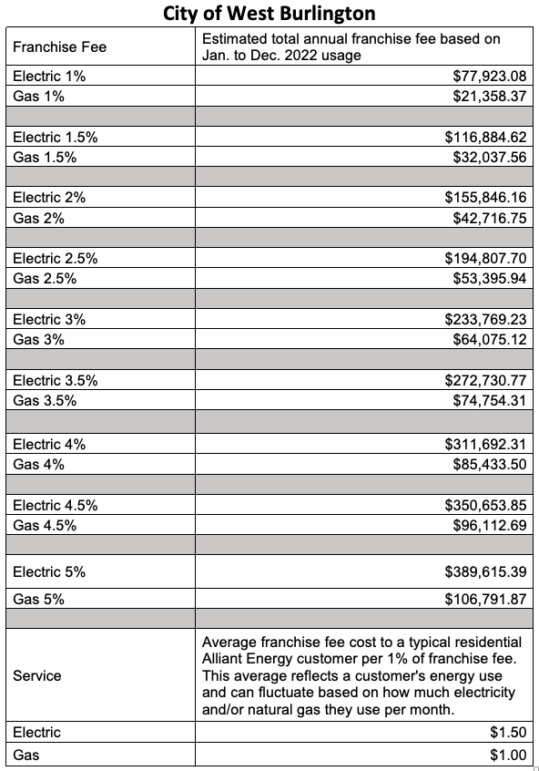
Supplemental Information
Alliant Franchise Fee Estimated Revenue @ 1% to 5%

Slide 22
Additional Projects (Planning Stages or CIP)
CIP
Business Park Road
Agency Street Trail
Sewer main – Potential for clay tile replacement (I&I)
Water main repairs/replacement
Street Repairs (CIP and 5-Year Street Plan)
24” Force Main, and more…

Slide 23
Supplemental & Historical Information

Slide 24
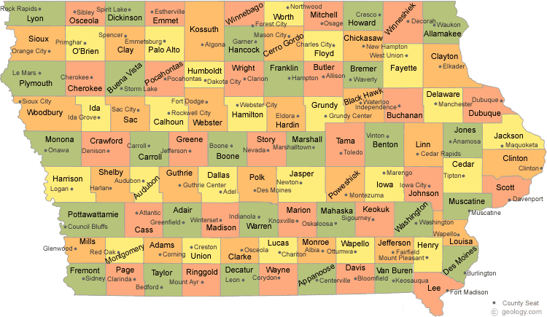

In Iowa, 259 cities have a lower tax rate, and 678 cities that have a higher tax rate for Fiscal Year 2023/2024. Out of 19 cities in the 2,500 to 3,500 population range 2 have lower tax rates and 20 are higher. They range from $5.54276 to $25.16806 with an average tax rate of $14.11264; compared to West Burlington’s tax levy rate of $10.00 for FY 2023/2024
Notes:
https://dom.iowa.gov/document/city-property-tax-rates 3/20/2024

Slide 25
Levy Rate Comparison With Other Cities in Des Moines County FY 2023/2024
Entity | Levy Rate 23/24
Burlington | $15.43637
Danville | 12.53120
Mediapolis | 11.50652
Middletown | 8.09999
West Burlington | 10.00838

Slide 26
100% Valuation History Valuations by Major Classes
Date of Valuations | Used for Budget Year | 100% Valuations w/o Ag | Rate of Growth | Residential | Commercial | Industrial
January 1, 2023 | FY 24/25 | 380,454,700 | 17.38% | 161,465,200 | 174,966,000 | 12,321,240
January 1, 2022 | FY 23/24 | 324,108,760 | 3.19% | 143,267,060 | 137,540,946 | 12,027,710
January 1, 2021 | FY 22/23 | 314,078,459 | 1.30% | 132,867,100 | 127,997,276 | 12,265,210
January 1, 2020 | FY 21/22 | 310,048,491 | 1.09% | 131,956,300 | 126,369,171 | 12,124,580
January 1, 2019 | FY 20/21 | 306,715,259 | 3.66% | 131,175,100 | 123,963,895 | 12,124,580
January 1, 2018 | FY 19/20 | 293,959,946 | 7.58% | 115,149,100 | 129,458,833 | 12,003,850
January 1, 2017 | FY 18/19 | 273,251,737 | 5.25% | 112,451,800 | 118,989,130 | 13,472,920
January 1, 2016 | FY 17/18 | 259,624,705 | 5.13% | 108,563,700 | 113,647,076 | 13,356,990
January 1, 2015 | FY 16/17 | 246,960,856 | 5.07% | 107,535,400 | 103,346,811 | 14,353,720
Notes:
Got numbers from Iowa department of management – 100% valuations by class of property. https://dom-localgov.iowa.gov/saved-reports
Make sure and do pdf report off state website. Do not use excel report off website.

Slide 27
Taxable Valuations Used For Setting Levy Rate
 | 24/25 | 23/24 | 22/23 | 21/22 | 20/21 | 19/20
Regular | 189,445,111 | 174,057,074 | 179,833,216 | 184,010,063 | 176,953,451 | 158,254,039
Debt Service | 231,817,816 | 203,243,184 | 210,854,590 | 211,707,399 | 207,501,518 | 205,662,198
Ag Land | 1,481,799 | 1,467,619 | 1,569,968 | 1,479,518 | 1,434,671 | 823,405
Notes:
Valuations spreadsheet under budget & budget presentation
https://dom-localgov.iowa.gov/saved-reports

Slide 28
Taxable Valuations by Major Classes
Fiscal Year | Residential | Commercial | Industrial
24/25 | 74,827,549 | 140,904,821 | 10,563,234
23/24 | 78,295,526 | 109,216,620 | 10,346,100
22/23 | 71,918,616 | 115,197,549 | 11,038,689
21/22 | 74,435,688 | 113,732,255 | 10,912,122
20/21 | 72,243,656 | 111,567,507 | 10,912,122
19/20 | 65,540,633 | 116,512,951 | 10,803,465
18/19 | 62,546,618 | 107,090,217 | 12,125,628
17/18 | 61,815,126 | 102,282,369 | 12,021,291
16/17 | 59,817,554 | 93,012,131 | 12,918,348
Notes:
ia dept. of management property valuation system reports www.iowaonline.state.ia.us taxable valuations by class by levy authority

Slide 29
Property Tax Rollback
Rollback | Residential | Agricultural | Commercial | Industrial
16-17 | 55.6259% | 46.107% | 90.00% | 90.00%
17-18 | 56.9391% | 47.4996% | 90.00% | 90.00%
18-19 | 55.6209% | 54.4480% | 90.00% | 90.00%
19-20 | 56.9180% | 56.1324% | 90.00% | 90.00%
20-21 | 55.0743% | 81.4832% | 90.00% | 90.00%
21-22 | 56.4094% | 84.0305% | 90.00% | 90.00%
22-23 | 54.1282% | 89.6765% | 90.00% | 90.00%
23-24 | 54.6501% | 91.6430% | 90.00% | 90.00%
24-25 | 46.3428% | 71.8370% | 90.00% | 90.00%
Notes:
rollback

Slide 30
Tax Rate History
2016/17 | 10.00
2017/18 | 10.00
2018/19 | 10.00
2019/20 | 10.00
2020/21 | 10.00
2021/22 | 9.65
2022/23 | 10.0
2023/24 | 10.00
2024/25 | 10.10

Slide 31
City of West Burlington Property Taxes
Listed below are examples of what a residential house with an assessed value of $100,000 would pay in property taxes to the City of West Burlington.
Year | Assessed Valuation | Rollback | Taxable Value | Tax Rate | Taxes | Yearly Difference | Monthly Difference
16/17 | 100,000 | 55.6259% | 55,626 | 10.00 | 556 | -7.00 | -0.58
17/18 | 100,000 | 56.9391% | 56,939 | 10.00 | 569 | 13.00 | 1.08
18/19 | 100,000 | 55.6209% | 55,621 | 10.00 | 556 | -13.00 | -1.08
19/20 | 100,000 | 56.9180% | 56,918 | 10.00 | 569 | 13.00 | 1.08
20/21 | 100,000 | 55.0743% | 55,074 | 10.00 | 551 | -18.00 | -1.50
21/22 | 100,000 | 56.4094% | 56,409 | 9.65 | 544 | -7.00 | -.58
22/23 | 100,000 | 54.1282% | 54,128 | 10.00 | 541 | -3.00 | -.25
23/24 | 100,000 | 54.6501% | 54,650 | 10.00 | 546 | 5.00 | .40
24/25 | 100,000 | 46.3428% | 46,343 | 10.10 | 468 | -78.00 | -6.50
Notes:
Assessed values of commercial & residential

Slide 32
City of West Burlington Commercial Property Taxes
Listed below are examples of what a commercial property with an assessed value of $1,000,000 would pay in property taxes to the City of West Burlington.
 | Assessed |  | Taxable |  |  | Yearly
Year | Valuation | Rollback | Value | Tax Rate | Taxes | Difference
16/17 | 1,000,000 | 90.00% | 900,000 | 10.00 | 9,000 | -90
17/18 | 1,000,000 | 90.00% | 900,000 | 10.00 | 9,000 | 0
18/19 | 1,000,000 | 90.00% | 900,000 | 10.00 | 9,000 | 0
19/20 | 1,000,000 | 90.00% | 900,000 | 10.00 | 9,000 | 0
20/21 | 1,000,000 | 90.00% | 900,000 | 10.00 | 9,000 | 0
21/22 | 1,000,000 | 90.00% | 900,000 | 9.65 | 8,685 | -315
22/23 | 1,000,000 | 90.00% | 900,000 | 10.00 | 9,000 | 315
23/24 | 1,000,000 | 90.00% | 900,000 | 10.00 | 9,000 | 0
24/25 | 1,000,000 | 90.00% | 900,000 | 10.10 | 9,090 | 90
*FY 23/24 the first $150,000 will be rolled back into the residential percentage.
Notes:
Assessed value of commercial and residential

Slide 33
Property Tax History
City of West Burlington
Property Tax Rate History
Per $1,000 Assessed Valuation
 | West Burlington | City of West | Des Moines | Southeastern
 | School | Burlington | County | Community |  | % Levy | % Levy | % Levy
Fiscal Year | District Levy | Levy | Levies | College Levy | Total Levy | School | County | City
2016/2017 | 13.83135 | 10.00 | 8.05010 | 1.15788 | 33.03933 | 41.86% | 24.37% | 30.27%
2017/2018 | 14.02417 | 10.00 | 8.02888 | 1.15723 | 33.21028 | 42.23% | 24.18% | 30.11%
2018/2019 | 14.06043 | 10.00 | 8.03731 | 1.15723 | 33.25497 | 42.28% | 24.17% | 30.07%
2019/2020 | 14.52811 | 10.00 | 7.85105 | 1.15723 | 33.53639 | 43.32% | 23.42% | 29.82%
2020/2021 | 17.72384 | 10.00 | 7.59475 | 1.18723 | 36.50582 | 48.55% | 20.80% | 27.39%
2021/2022 | 16.73660 | 9.65 | 7.54733 | 1.24723 | 35.18116 | 47.57% | 21.45% | 27.43%
2022/2023 | 14.85110 | 10.00 | 7.37135 | 1.29223 | 33.51468 | 44.31% | 21.99% | 29.84%
2023/2024 | 14.05057 | 10.00 | 7.39726 | 1.48623 | 32.93406 | 42.66% | 22.46% | 30.36%
Notes:
Property tax rate history
County rate includes: county, brucellosis, assessor, ag ext.

Slide 34
City of West Burlington Levy Rates
Notes:
Spreadsheet/leslie/budget/budget presentation/levy rates

Slide 35
General Fund

Slide 36
General Fund
The General Fund is the chief operating fund of the City. This fund supports those operations most identified with the city, such as fire and police. The largest revenue received in the general fund is property taxes. It also receives all other income that is not required by law or contractual agreement to be deposited elsewhere. Also included is revenue from licenses, permits, and earnings of investments.
For FY 24/25 General Fund Revenues are budgeted at $3,613,955 and expenses of $3,555,057. Expenditures exceed revenues by $240,551. At the end of FY 24/25, the General fund is estimated to have a balance of $754,350.49.
This results in a General Fund Fund Balance of 21.22%.
Notes:
Run budget comparison report in tyler and get year totals or use revenue less expenses spreadsheet.

Slide 37
General Fund Decrease/Increase – Expenditures v. Revenues
Notes:
Update spreadsheet general fund balances spend down actual2

Slide 38
Enterprise Funds

Slide 39
Tax Increment Financing
For FY24/25 the City budgeted to receive $1,117,967 in TIF property tax revenues.; up from $756,527 for FY 23/24. The following expenses are to be paid in FY24/25:
TIF Debt | Amount
Campus Community Developers | 49,246 | TIF Rebate – Black Hawk Tower
2017 GO Bond | 590,600 | Street Projects
2015 Residential Develop. | 7,824 | Internal Loan
Legal Services | 11,477 | Internal Loan
Greater Burlington Partnership | 5,000 | Partnering for the Future
Administration Fee (Wages) | 81,000 | Administrative and Professional Support
Consultation Fees | 400 | Internal Loan
Potential Shortfall | 350,000 | Hospital Tax Dispute

Slide 40
Road Use Tax Fund

Slide 41
Road Use Tax Fund (RUTF)
The Road Use Tax Fund comes from vehicle registration fees, motor vehicle fuel taxes, an excise tax imposed on the rental of automobiles, and a use tax on trailers. Distribution is based on population.
The amount estimated by the state for FY 24/25 is a distribution rate of $133.00 per capita. Economic instability and fluctuating fuel costs can result in changes in the fund. In FY 14/15 the State increased the gas tax by ten cents per gallon which resulted in an annual increase of approximately $50,000.
The City budgeted to receive $460,000 from Road Use taxes and $208,950 in other revenue sources totaling $668,950 in revenue and expenditures of $766,165. The expenditures include $54,000 in Capital Outlay – Vehicles, $18,000 in Capital Outlay – Major Equipment, and $97,690 for HMA crack fill.

Slide 42
Road Use Tax Revenues
FY | Amount | % Increase/Decrease
16/17 | 373,920.75 | 0.5%
17/18 | 384,301.51 | 2.8%
18/19 | 389,107.38 | 1.2%
19/20 | 387,157.58 | -0.5%
20/21 | 450,782.67 | 16.4%
21/22 | 437,320.40 | -3.1%
22/23 | 445,384.30 | 1.8%

Slide 43
Local Option Sales Tax

Slide 44
Local Option Sales Tax Revenues
The City is obligated to use twenty-five percent of the proceeds for property tax relief to pay off outstanding general obligation debt. The remainder of the proceeds shall by used for police department and fire department services, capital improvements, capital equipment or to pay off other debt obligations.
FY | Amount | % Increase/Decrease
16/17 | 605,943 | 9%
17/18 | 496,058 | -18%
18/19 | 482,335 | -3%
19/20 | 520,000 | 7%
20/21 | 642,593 | 19%
21/22 | 535,000 | -17%
22/23 | 667,830 | 20%
23/24 | 650,000 | -3%
24/25 | 607,000 | -7%

Slide 45
Local Option Sales Tax Expenditures
Revenues are estimated at $668,950 and expenditures are budgeted at $766,165 reducing the estimated fund balance for FY24/25.
Budgeted Expenditure | Amount Budgeted
Police and Fire Expenditures | 223,240
Debt Service Payments SRF Water Loan | 26,000
Internal Loan Sewer Jet Truck | 25,000
Ambulance | 22,400
Library | 51,510
Airport | 23,220
Capital Street Projects & Sidewalk HMA Crackfill $97,690 Trailhead LED Sign $50,000 Sidewalks – $35,000 | 182,690
Streets Capital Outlay – Equipment | 62,105
Fire Capital | 100,000
Police Capital | 50,000

Slide 46
Revenues & Expenditures

Slide 47
Revenues by Source The city has budgeted to receive $8,577,482 in revenues excluding transfers of $3,676,642.

Slide 48
Tax Revenue Breakdown
The City receives approximately 3.5 million of its revenue from taxes. The breakdown of where those taxes come from is shown below.
Notes:
Revenues by source , tax rev breakdown

Slide 49
Expenditures by Function Excluding Transfers
Notes:
Check against state form for department totals - function list

Slide 50
Hotel Motel Taxes

Slide 51
Hotel Motel Taxes
Revenues are estimated at $80,000 for FY 2024/2025 and expenditures and budgeted at $103,500. 51% of the revenue is allocated to the City and 49% of the revenue is allocated to the CVB. The estimated year-end fund balance is $129,188.
This is a decrease of 12.8% from FY 2023/2024.

Slide 52
Hotel Motel Tax
FY | Amount | % Increase/Decrease
15/16 | 44,538.13 | 8%
16/17 | 43,749.16 | -2%
17/18 | 30,115.36 | -31%
18/19 | 45,482.64 | 34%
19/20 | 55,904.80 | 19%
20/21 | 51,861.46 | -7%
21/22 | 75,519.52 | 46%
22/23 | 82,648.44 | 9%

Slide 53
Capital Projects and Capital Equipment Reserves

Slide 54
Capital Projects & Equipment
Project | Amount | Funding
Sidewalks | $ 35,000 | LOST
Fire Dept. – Training Site Improvements and SCBA Compressor | $ 60,000 | General Fund $15,000 & Fire Capital Reserve $45,000
Gear Ave. Trail Phase #2 | $ 1,500,000 | SRT Grant $345,357 TAP Grant $548,111 TIF $630,000
Police Department – New Radios | $ 35,000 | General Fund
HMA Crackfill | $ 97,690 | LOST
Street Dept. – 2025 Sourcewell Dump Truck Kubota Tractor | $ 72,000 | LOST $62,105 Road Use Tax $9,895
Water Dept. – 2025 Sourcewell Dump Truck Kubota Tractor | $ 72,000 | Water Fund
Water Main Repair | $ 200,000 | Water Fund
Sewer Dept. – 2025 Sourcewell Dump Truck Kubota Tractor | $ 72,000 | Sewer Fund
Stormwater Project | $107,500 | TIF
Total Projects & Equipment | $ 2,199,170

Slide 55
Transfers to Capital Funds
Description | FY 23/24 Amount | FY 24/25 Amount | Funding
City Hall Capital Reserve | 5,000 | 5,000 | General Fund
Public Works Capital Fund | 0 | 20,056 | Administration Capital Reserve
Fire Capital Equipment Fund | 100,000 | 100,000 | LOST
Police Department Capital Fund | 65,000 | 50,000 | LOST
Pool Capital Equipment Fund | 15,000 | 0 | General Fund
IT Capital Equipment Fund | 20,000 | 20,000 | General Fund/Water/Sewer
Streets Capital Equipment Fund | 30,000 | 0 | General Fund
Parks Capital Equipment Fund | 10,000 | 10,000 | General Fund
Water Capital Account | 30,000 | 30,000 | Water Fund
Sewer Capital Account | 25,000 | 0 | Sewer Fund

Slide 56
Debt

Slide 57
Debt
Issue | Purpose | Amt. of Issue | Fund | Principal | Interest | Fees | Total Payment
2017 GO Bond Maturity 2026/2027 | Street Resurface/Reconstruction | 3,780,000 | TIF | 540,000 | 50,100 | 500 | 590,600
SRF GO Bond Maturity 2027/2028 | Water Project | 400,000 | LOST | 24,000 | 1,750 | 250 | 26,000
SRF Water Revenue Bond Maturity 2027/2028 | Water Project | 330,000 | Water | 22,000 | 1,610 | 230 | 23,840
SRF Water Revenue Bond Maturity 2039/2040 | Water Tower Project | 5,977,000 | Water | 222,000 | 70,980 | 10,140 | 303,120
SRF Sewer Revenue Bond Maturity 2037/2038 | Wastewater Plant Improvement | 11,450,000 | Sewer | 527,000 | 93,075 | 21,348 | 641,423
SRF Sewer Revenue Bond Maturity 2039/2040 | South Lift Station | 1,189,000 | Sewer | 53,000 | 17,220 | 2,460 | 72,680
Campus Community Developers Rebates | Rebate Agreement |  | TIF |  |  |  | 49,246
2022 GO Bond Maturity 2031/2032 | Mt. Pleasant Street Phase #2 | 525,000 | Debit Levy | 50,000 | 8,600 | 500 | 60,100
Totals |  |  |  | 1,438,000 | 243,335 | 35,428 | 1,767,009
According to the Iowa Constitution a City’s maximum debt capacity is 5% of the City’s 100% assessed value (380,454,700) which would be a maximum debt capacity of 19,022,735.
The City will begin FY23/24 at 14.81% of debt limit capacity (2,818,000) and will end the year 11.6% (2,206,000 Water and sewer revenue debt and internal loans are not included in maximum debt capacity calculations.
Notes:
Check with debt service page – exception water & sewer revenue bonds

Slide 58
THANK YOU
I would like to thank everyone involved in preparing the budget. It was a team effort from the start working with City Department Heads and their staff and on through the budget presentations working with the Mayor and Council. A special tank you to our Finance Manager Angie Moore for her many hours of work on the proposed and final budget.
This is the most important policy document the City Council adopts on an annual basis and provides a road map for the coming fiscal year. It is a living document that is a guide, but things can and do change throughout the year as do priorities and we need to have a budget that is flexible and can accommodate today’s changing municipal environment.
Gregg Mandsager
City Administrator
April 3, 2024

