Slide 1
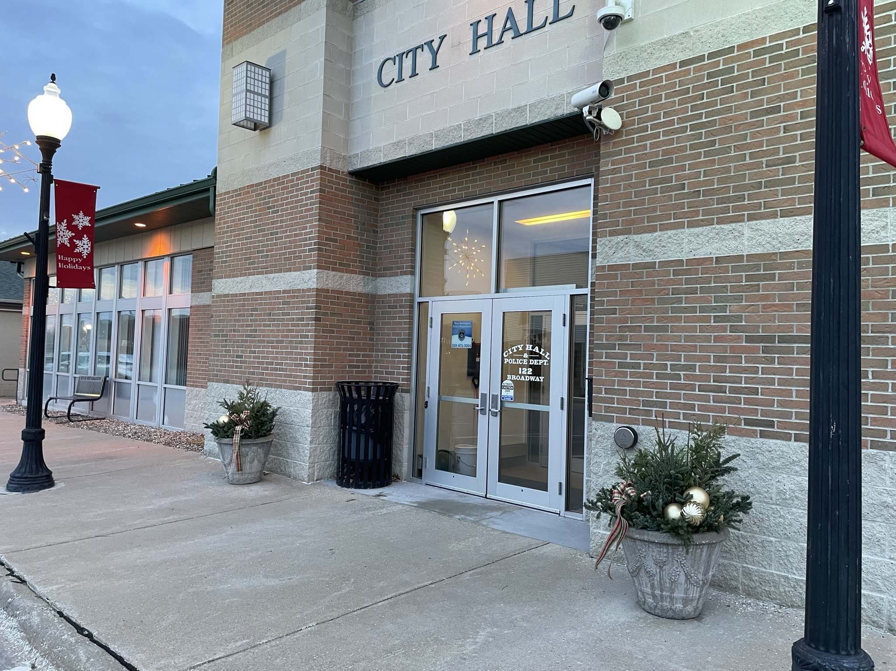

City of West Burlington
Budget Presentation
Fiscal Year 2025-2026
Gregg Mandsager, City Administrator
Angela Moore, Finance Manager

Slide 2
Introduction
The proposed budget:
Tackles the challenges to property taxes created by HF 718 and takes into account our new taxable valuations. The Legislature is considering significant changes to property taxes again this session - see HSB 313 and SSB 1208.
HF 718 does not allow the City to address two years of negative growth county wide. This one size fits all solutions are not appropriate.
Continues to address capital project and equipment needs in coordination with capital improvement/equipment planning,
Maintains service levels, and
Maintains a strong General Fund Balance.

Slide 3
Changes to the Budget as Proposed
Levy Rate: FY 2023/2024 $10.00, FY 2024/2025 $10.10, FY 2025/2026 $10.10.
Discussed reviewing the sewer rate structure. A 5% rate increase is budgeted.
Due to a 9% water rate increase from Burlington Waterworks, a 3.6% increase in rates is needed for next fiscal year in lieu of a 2% increase. We are still absorbing the last 5% increase from Waterworks. This allows the City to maintain a positive fund balance and meet SRF requirements.
The purchase of a sewer camera for maintenance and emergencies.
Slip lining two sections of sewer main to extend the useful life, prevent I&I, and other problems related to old tile lines.
Removed the building addition for the police department and will review it next fiscal year.
Adjusted the IT Microsoft subscriptions for City Council and the Police Reserves and also cancelled Creative Cloud Stock Images for a total savings of $2,300 annually.
City Council requested an additional $2,400 to the budget designated for Employee Appreciation.

Slide 4
Tax Rate History
The proposed 2025/26 budget reflects a proposed tax rate of $10.10/$1,000 of taxable property valuation.
2010/11 9.86
2011/12 9.80
2012/13 9.80
2013/14 9.75
2014/15 10.10
2015/16 10.10
2016/17 10.00
2017/18 10.00
2018/19 10.00
2019/20 10.00
2020/21 10.00
2021/22 9.65
2022/23 10.00
2023/24 10.00
2024/25 10.10

Slide 5

General Fund Balance
The proposed budget decreases the General Fund Balance from 21.22% to 20.90%. Bringing the GF to $724,240.57 v. $754,350.49.
The budget designates $200,000 in a one-time transfer for watermain projects in FY 2025-2026 and a one-time transfer to a general undesignated capital project fund.
Having a strong General Fund balance and a Fund Balance Policy in place will allow time for staff and City Council to plan for how to address revenue reductions or emergencies should they occur.

Slide 6
Fund Balance Comparison
Fund | FY 22/23 | FY 23/24 | FY 24/25 | FY 25/26
General Fund | $847,735.71 | $782,508.68 | $754,350.49 | $724,240.57
Hotel/Motel | $146,147.53 | $147,722.00 | $129,188.19 | $78,447.33
RUTF | $135,829.16 | $55,049.16 | $8,409.44 | $984.25
LOST | $513,058.42 | $744,856.56 | $579,772.56 | $520,682.89
Water | $354,171.89 | $1,295,054.91 | $43,192.22 | $5,646.30
Sewer | $95.193.68 | $30,115.39 | $217,240.93 | $888.97
*Water: Property and Liability insurance increased by 26.2% and a 9% rate increase by Burlington for water.
*Sewer: Property and Liability insurance increased by 26.2%, 24” Force Main Study, sewer slip lining, sewer camera, 9% Burlington

Slide 7
Property Valuations
Actual Valuations (100%)
FY 2021/21 $308,287,791
FY 2022/23 $312,315,259
FY 2023/24 $313,186,360
FY 2024/25 $382,556,691
FY 2025/26 $359,089,600 (Note that this is an estimate as the county did not provide SEIRMC 100% valuations).
Taxable Valuations
Increased from a total of $218,567,215 to $221,221,037 (an increase of $2,653,822)
Residential Rollback went from 46.3428% compared to 47.4316%.
Residential valuations increased by $3,058,531.
Commercial Property remained at the 90% rollback. Commercial valuations decreased by $774,668
Industrial property remained at the 90% rollback. Industrial valuations decreased by $252,700
Note: New in FY 2023/24 year is an automatic Business Property Tax Credit that makes the first $150,000 of taxable valuation for commercial, industrial and railroad subject to the residential rollback of $56.4919 before applying the 90% rollback. The State is providing a rollback for a limited time.
Notes:
Actual Valuations are 100% Valuation Military Exemptions Deducted
Taxable Valuation. Taxable Valuations Commercial Property: FY22/23 115,197,549 FY23/24 290,501,160-183,036,668(hospital)=107464,492

Slide 8
100% and Taxable Valuation Comparison

Slide 9
SEIRMC Taxable Valuations
Here is a comparison of the hospital valuations and the loss in taxable value
from the hospital in 2023 and 2024. 2021 is the best comparable for us to use for this next fiscal year.
$195,657,385 Reduction in Taxable Valuation
$14,732,400 Reduction Compared to 2021 Taxable Valuations
$133,272.60 Reduction in Property Taxes, just over $33,000 per year on average

Slide 10
Tax Levy
Tax Rate FY 23/24 FY 24/25 FY 25/26
General Levy (maximum) 8.10 7.94117 8.10
Liability (Insurance) Levy 0.95888 0.74630 0.83610
FICA/IPERS 0.42884 0.79581 0.58211
Employee Benefits Levy 0.22871 0.38242 0.31505
Debt Service Levy 0.29137 0.14286 0.26698
Emergency Levy 0.00000 0.00000 0.0000
The new general fund levy following Property Tax Legislation is $8.10.
Total Proposed Levy $10.10
Property Tax Revenue @ $10.10: FY 24/25=$1,898,909, FY 25/26=$1,872,281

Slide 11
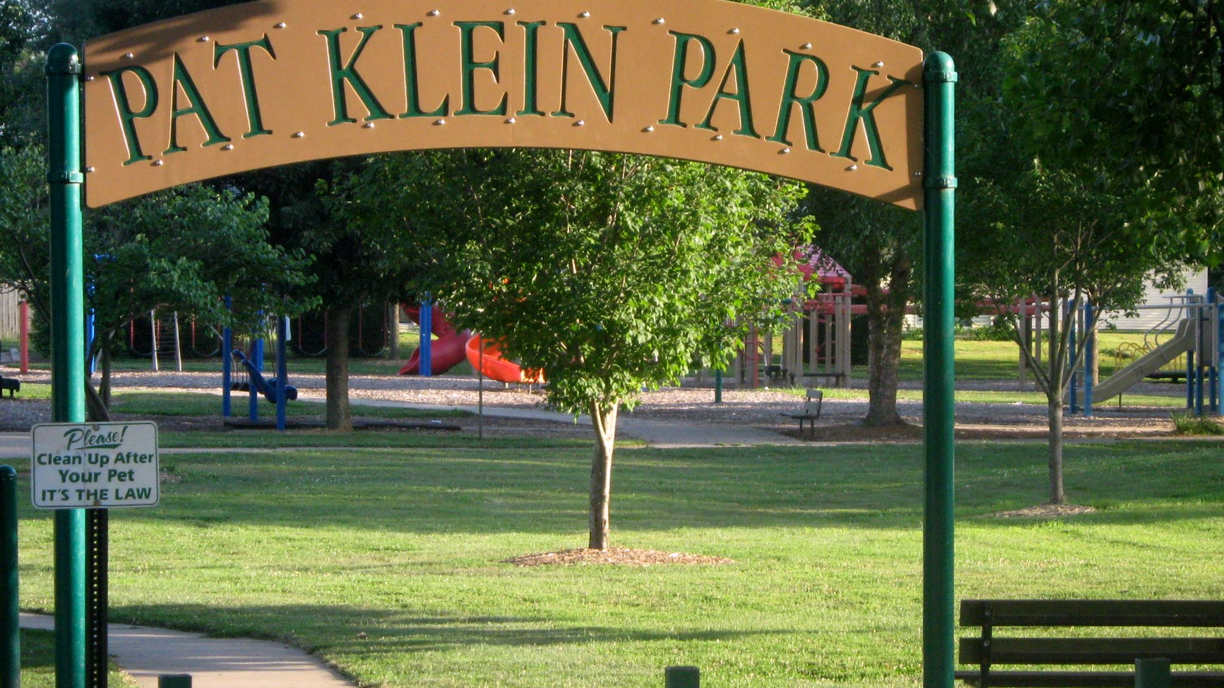
Budget Issues and Challenges
For Fiscal Years 2022-2030, the annual reduction in backfill (property taxes) for the City of West Burlington will be as follows (estimated amount distributed to the city until phased out in 2030):
2022 $111,430.59
2023 $97,501.76
2024 $83,572.94 (Revised $80,031)
2025 $69,644.12
2026 $55,715.29
2027 $41,786.47
2028 $27,857.65
2029 $13,928.82
2030 $0.00

Slide 12
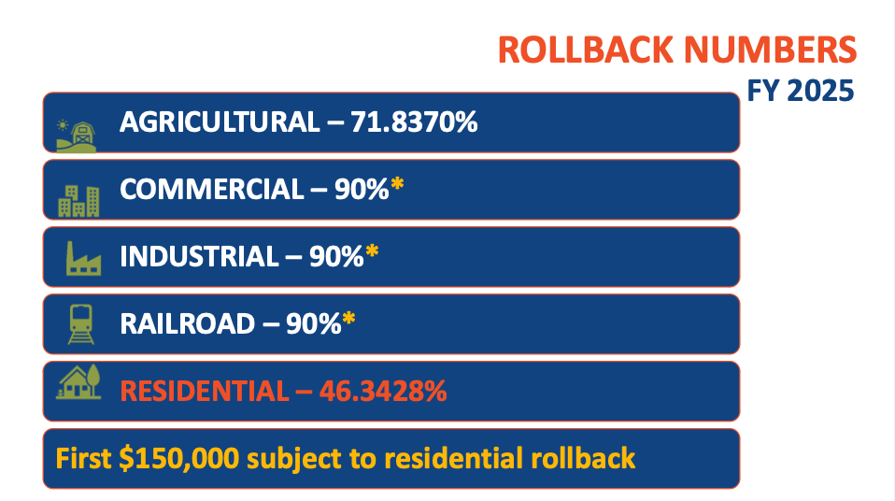
Roll Back
*Provided by the Iowa League of Cities

Slide 13
Budget Issues and Challenges
CPI
US CPI September 2022 8.2%, September 2023 3.7%, September 2024 2.4%
Midwest CPI September 2022 8.1%, September 2023 3.2%, September 2024 2.5%
Municipal Cost Index September 2022 9.14%, September 2023 1.42%, September 2024 0.76%
Rollback
2022 Residential 56.4094%
2023 Residential 54.1302%
2024 Residential 54.6501%
2025 Residential 46.3428%
2023 Multi-Res 63.75% (2024 Same as residential)
2024 Multi-Res 54.6501% (Class eliminated, now using residential rate)
2025 Multi-Res 46.3428% (8.3073% reduction)
2022 Multi-Res 67.50%
2026 Residential 47.4316% (increase 1.09%)
2026 Multi-Res 47.4316% (increase 1.09%)

Slide 14
Budget Issues and Challenges
The residential rollback rate has seen a minimal increase for the coming fiscal year 1.09% (FY 2024/25 the rollback decreased 8.03%)
We are impacted this next fiscal year by the SEIRMC decrease in valuation by $195,657,385 or $14,732,400 over 2021, a loss of $133,272.60 over four years, or just over $33,000 per year.
Elimination of Multi-Res Property Class in FY 23/24
Business Property Tax Credit FY 23/24
Reduction in Backfill
CPI or Cost of Living (and other indexes)
Balancing our CIP needs, timing, and funding sources

Slide 15
Key Items
Capital Equipment 5-year Outlook and CIP provided.
The IT budget includes all computers others than squad cars.
Transfers were modified based on capital equipment and project needs.
The budget includes a 4% cost of living increase per contract for Public Works Employees, Police Officers and Non-Union Employees.
TIF Admin fees have been included as a transfer to support the general fund.
Wages for the city administrator, city clerk, finance staff, and IT are broken out 25% each in the general fund, water, sewer, and streets (plus TIF admin fee)
Health insurance is budgeted at a 0% increase (IGHCP administrative increase); We are setting aside additional funds for the medical self-insurance fund which was not addressed when the City switched programs. 2.5% increase employee share.
Property/Liability Insurance increased by 26.2%. We hope to see a reduction in work comp rates to offset this increase or explore new carriers (July 1 Start date).

Slide 16
Rate Adjustments
Pool admissions: Free ages 0-2, $5 ages 3 +, individual season pass $75, coupon books $40 (10 coupons),and Private Pool Parties $400 (up to 100 guests), $500 (over100 guests)
Garbage Rates: Increase 3% ($14.85 to $15.30)
Recycling rates have been adjusted to reflect the increase in costs ($4.35 to $4.45)
Water Rates: Increase 3.6%; FY 23/24 to FY 24/25 No Change, FY 25/26 $33.87 to $34.55 (First 3,000 Gallon)
Sewer Rates: Increase 5%; FY 23/24 = $11.91, FY 24/25 $12.15, FY 25/26 $11.68 (This rate increase generates $69,855.27).
A 3.6% water rate increase would generate $58,278.60 to offset the 9% rate increase from Burlington, provide for a positive fund balance and cover SRF debt.
DISCUSSION TOPIC: Reminder that Speer Financial recommends a 2% annual rate increases every other year starting in FY 2024/25 for water and sewer to maintain sufficient revenues versus expenditures and to meet SRF requirements.

Slide 17
Property Taxes - Examples
$100,000 Home
2021/22 @ 9.65 rate and 56.4094% rollback = $544.35 in taxes
2022/23 @ 10.00 rate and 54.1302% rollback = $541.30 in taxes
2023/24 @ 10.00 rate and 54.6501% rollback = $546.50 in taxes
2024/25 @ 10.10 rate and 46.3428% rollback = $468.06 in taxes
2025/26 @ 10.10 rate and 47.4316% rollback = $479.06 in taxes
$200,000 Home
2021/22 @ 9.65 rate and 56.4094% rollback = $1088.70 in taxes
2022/23 @ 10.00 rate and 54.1302% rollback = $1082.60 in taxes
2023/24 @ 10.00 rate and 54.6501% rollback = $1093.00 in taxes
2024/25 @ 10.10 rate and 46.3428% rollback = $936.12 in taxes
2025/26 @ 10.10 rate and 47.4316% rollback = $958.12 in taxes
$100,000 Commercial
2021/22 @ 9.65 rate and 90% rollback = $868.50 in taxes
2022/23 @ 10.00 rate and 90% rollback = $900 in taxes
2023/24 @ 10.00 rate and 54.6501% rollback on first $150,000, 90% remainder = $564.92 in taxes
2024/25 @ 10.10 rate and 46.3428% rollback on first $150,000, 90% remainder = $468.06 in taxes
2025/26 @ 10.10 rate and 47.4316% rollback on first $150,000, 90% remainder = $479.06 in taxes
$200,000 Commercial
2021/22 @ 9.65 rate and 90% rollback = $1737 in taxes
2022/23 @ 10.00 rate and 90% rollback = $1800 in taxes
2023/24 @ 10.00 rate and 54.6501% rollback on first $150,000, 90% remainder = $1,269.75 in taxes
2024/25 @ 10.10 rate and 46.3428% rollback on first $150,000, 90% remainder = $1,156.59 in taxes
2025/26 @ 10.10 rate and 47.4316% rollback on first $150,000, 90% remainder = $1,173.09 in taxes
*This is a significant reduction in property taxes over the past four years (in total)!
Notes:
Updated 3/25

Slide 18
FY 2025-26 Proposed Budget Summary
The proposed 2025/26 budget is a balanced with budgeted revenues exceeding budgeted expenditures (after transfers).
Capital Projects: Force main Design, Agency & Broadway Street Trails Design, Sealcoating & HMA crack filling, water main replacement, sewer slip lining and amendments to address any successful grants (stormwater, sanitary sewer, etc.).
Challenging to maintain existing levels of the services to the community and positioning the City to meet new challenges, and the city may be hard pressed to address capital project and equipment needs without borrowing.
Future challenges likely involve potential shortfalls in revenues from limited growth in taxable valuations and the new property tax legislation!
Discussion Items: Levy rate, sewer rates (Structure), borrowing (GO TIF Bond, no increase in debt, no increase in levy due to bond).

Slide 19
Supplemental Information
Water Rates

Slide 20
Supplemental Information
Sewer Rates

Slide 21
Supplemental Information
Note: Prior Year’s Data
Alliant provided the following related to franchise fees:
Franchise fee estimates based on 2022 calendar year usage. These estimates are calculated down to the penny, but remember energy use, the weather and other factors can control these numbers. They are paid at the end of January, April, July and October. These fees are charged to all energy users, except the city. So any tax exempt business, group or school will have to pay the franchise fee.
Franchise fees and LOST are an “either or” on energy bills. With LOST, West Burlington currently gets $7.99 for every $100 it collects. With a franchise fee, the town would get to keep all of the revenue.
*Reminder that franchise fees apply to all users, including non-profits (hospital, church, etc.) and not simply property owners.
*Recommendation (original): That we at a minimum adopt a franchise fee ordinance and enter into an agreement even if the city chooses to leave the fee at 0%. Thereby allowing the City to modify the fee with 90 days notice to Alliant. (0% to 5%).

Slide 22
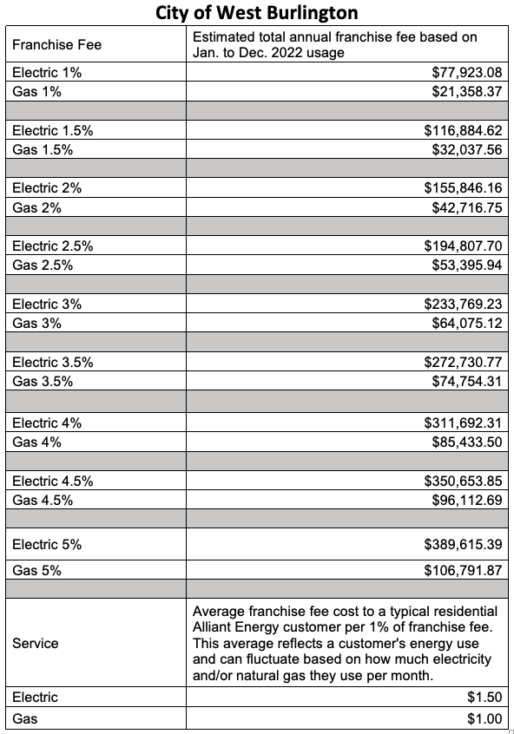
Supplemental Information
Alliant Franchise Fee Estimated Revenue @ 1% to 5% (2022 Usage)
Franchise Fee Revenues: YTD $110,073.41

Slide 23
Projects
Watermain Project (Pat Klein)
Mall Ring Road: Initial repair and design
Agency Street Trail (Broadway TBD and Intersections): Final Design
24” Force Main: Final design
Stormwater: 60% design (BRIC Grant, including more details on lake)
Mt Pleasant Street Phase 3 & 4: Final design
Sewer: Sewer main slip lining

Slide 24
Supplemental & Historical Information

Slide 25
Tax Rate Comparison
In Iowa, there are 251 cities with a lower tax rate and 677 cities with a higher tax rate for Fiscal Year 2024/2025.
Among 29 cities with populations between 2,500 and 3,500, 3 have lower tax rates while 24 have higher rates.
The tax rates vary from $7.44063 to $25.16806, with an average rate of $14.2824, in contrast to West Burlington’s tax levy rate of $10.10 for FY 2024/2025.
Notes:
https://dom.iowa.gov/document/city-property-tax-rates 3/20/2024

Slide 26
Levy Rate Comparison With Other Cities in Des Moines County FY 2024/2025
Entity | Levy Rate 24/25
Burlington | $15.43637 (.40 increase 25/26)
Danville | $12.59194
Mediapolis | $11.50652
Middletown | $8.52016
West Burlington | $10.10023

Slide 27
100% Valuation History Valuations by Major Classes
Date of Valuations | Used for Budget Year | 100% Valuations w/o Ag | Rate of Growth | Residential | Commercial | Industrial
January 1, 2024 | FY 25/26 | 359,089,600 | -5.62% | 164,207,080 | 149,687,919 | 12,068,540
January 1, 2023 | FY 24/25 | 380,454,700 | 17.38% | 161,465,200 | 174,966,000 | 12,321,240
January 1, 2022 | FY 23/24 | 324,108,760 | 3.19% | 143,267,060 | 137,540,946 | 12,027,710
January 1, 2021 | FY 22/23 | 314,078,459 | 1.30% | 132,867,100 | 127,997,276 | 12,265,210
January 1, 2020 | FY 21/22 | 310,048,491 | 1.09% | 131,956,300 | 126,369,171 | 12,124,580
January 1, 2019 | FY 20/21 | 306,715,259 | 3.66% | 131,175,100 | 123,963,895 | 12,124,580
January 1, 2018 | FY 19/20 | 293,959,946 | 7.58% | 115,149,100 | 129,458,833 | 12,003,850
January 1, 2017 | FY 18/19 | 273,251,737 | 5.25% | 112,451,800 | 118,989,130 | 13,472,920
January 1, 2016 | FY 17/18 | 259,624,705 | 5.13% | 108,563,700 | 113,647,076 | 13,356,990
Notes:
Got numbers from Iowa department of management – 100% valuations by class of property. https://dom-localgov.iowa.gov/saved-reports
Make sure and do pdf report off state website. Do not use excel report off website.

Slide 28
Taxable Valuations Used For Setting Levy Rate
 | 25/26 | 24/25 | 23/24 | 22/23 | 21/22 | 20/21
Regular | 188,539,110 | 189,445,111 | 174,057,074 | 179,833,216 | 184,010,063 | 176,953,451
Debt Service | 219,752,806 | 231,817,816 | 203,243,184 | 210,854,590 | 211,707,399 | 207,501,518
Ag Land | 1,468,231 | 1,481,799 | 1,467,619 | 1,569,968 | 1,479,518 | 1,434,671
Notes:
Valuations spreadsheet under budget & budget presentation
https://dom-localgov.iowa.gov/saved-reports

Slide 29
Taxable Valuations by Major Classes
Fiscal Year | Residential | Commercial | Industrial
25/26 | 77,886,080 | 126,000,040 | 10,348,919
24/25 | 74,827,549 | 140,904,821 | 10,563,234
23/24 | 78,295,526 | 109,216,620 | 10,346,100
22/23 | 71,918,616 | 115,197,549 | 11,038,689
21/22 | 74,435,688 | 113,732,255 | 10,912,122
20/21 | 72,243,656 | 111,567,507 | 10,912,122
19/20 | 65,540,633 | 116,512,951 | 10,803,465
18/19 | 62,546,618 | 107,090,217 | 12,125,628
17/18 | 61,815,126 | 102,282,369 | 12,021,291
Notes:
ia dept. of management property valuation system reports www.iowaonline.state.ia.us taxable valuations by class by levy authority

Slide 30
Property Tax Rollback
Rollback | Residential | Agricultural | Commercial | Industrial
17-18 | 56.9391% | 47.4996% | 90.00% | 90.00%
18-19 | 55.6209% | 54.4480% | 90.00% | 90.00%
19-20 | 56.9180% | 56.1324% | 90.00% | 90.00%
20-21 | 55.0743% | 81.4832% | 90.00% | 90.00%
21-22 | 56.4094% | 84.0305% | 90.00% | 90.00%
22-23 | 54.1282% | 89.6765% | 90.00% | 90.00%
23-24 | 54.6501% | 91.6430% | 90.00% | 90.00%
24-25 | 46.3428% | 71.8370% | 90.00% | 90.00%
25-26 | 47.4316% | 73.8575% | 90.00% | 90.00%
Notes:
rollback

Slide 31
City of West Burlington Property Taxes
Listed are examples of what a residential house with an assessed value of $100,000 would pay in property taxes to the City of West Burlington.
Year | Assessed Valuation | Rollback | Taxable Value | Tax Rate | Taxes | Yearly Difference | Monthly Difference
17/18 | 100,000 | 56.9391% | 56,939 | 10.00 | 569 | 13.00 | 1.08
18/19 | 100,000 | 55.6209% | 55,621 | 10.00 | 556 | -13.00 | -1.08
19/20 | 100,000 | 56.9180% | 56,918 | 10.00 | 569 | 13.00 | 1.08
20/21 | 100,000 | 55.0743% | 55,074 | 10.00 | 551 | -18.00 | -1.50
21/22 | 100,000 | 56.4094% | 56,409 | 9.65 | 544 | -7.00 | -.58
22/23 | 100,000 | 54.1282% | 54,128 | 10.00 | 541 | -3.00 | -.25
23/24 | 100,000 | 54.6501% | 54,650 | 10.00 | 546 | 5.00 | .40
24/25 | 100,000 | 46.3428% | 46,343 | 10.10 | 468 | -78.00 | -6.50
25/26 | 100,000 | 47.4316% | 47,432 | 10.10 | 479 | 11.00 | .92
 |  |  |  |  | Net: | -77.00
Notes:
Assessed values of commercial & residential

Slide 32
City of West Burlington Commercial Property Taxes
Listed below are examples of what a commercial property with an assessed value of
$1,000,000 would pay in property taxes to the City of West Burlington.
 | Assessed |  | Taxable |  |  | Yearly
Year | Valuation | Rollback | Value | Tax Rate | Taxes | Difference
17/18 | 1,000,000 | 90.00% | 900,000 | 10.00 | 9,000 | 0
18/19 | 1,000,000 | 90.00% | 900,000 | 10.00 | 9,000 | 0
19/20 | 1,000,000 | 90.00% | 900,000 | 10.00 | 9,000 | 0
20/21 | 1,000,000 | 90.00% | 900,000 | 10.00 | 9,000 | 0
21/22 | 1,000,000 | 90.00% | 900,000 | 9.65 | 8,685 | -315
22/23 | 1,000,000 | 90.00% | 900,000 | 10.00 | 9,000 | 315
23/24 | 1,000,000 | 90.00% | 900,000 | 10.00 | 9,000 | 0
24/25 | 1,000,000 | 90.00% | 900,000 | 10.10 | 9,090 | 90
25/26 | 1,000,000 | 90.00% | 900,000 | 10.10 | 9,090 | 0
*FY 23/24 the first $150,000 will be rolled back into the residential percentage.
Notes:
Assessed value of commercial and residential

Slide 33
Property Tax History
City of West Burlington
Property Tax Rate History
Per $1,000 Assessed Valuation
 | West Burlington | City of West | Des Moines | Southeastern
 | School | Burlington | County | Community |  | % Levy | % Levy | % Levy
Fiscal Year | District Levy | Levy | Levies | College Levy | Total Levy | School | County | City
2017/2018 | 14.02417 | 10.00 | 8.02888 | 1.15723 | 33.21028 | 42.23% | 24.18% | 30.11%
2018/2019 | 14.06043 | 10.00 | 8.03731 | 1.15723 | 33.25497 | 42.28% | 24.17% | 30.07%
2019/2020 | 14.52811 | 10.00 | 7.85105 | 1.15723 | 33.53639 | 43.32% | 23.42% | 29.82%
2020/2021 | 17.72384 | 10.00 | 7.59475 | 1.18723 | 36.50582 | 48.55% | 20.80% | 27.39%
2021/2022 | 16.73660 | 9.65 | 7.54733 | 1.24723 | 35.18116 | 47.57% | 21.45% | 27.43%
2022/2023 | 14.85110 | 10.00311 | 7.36824 | 1.29223 | 33.51468 | 44.31% | 21.99% | 29.84%
2023/2024 | 14.05057 | 10.00 | 7.38888 | 1.48623 | 32.93406 | 42.66% | 22.44% | 30.39%
2024/2025 | 13.19497 | 10.10 | 7.38175 | 1.5567 | 32.23365 | 40.94% | 22.90% | 31.33%
Notes:
Property tax rate history
County rate includes: county, brucellosis, assessor, ag ext.

Slide 34
City of West Burlington Levy Rates
Notes:
Spreadsheet/leslie/budget/budget presentation/levy rates

Slide 35
General Fund

Slide 36
General Fund
The General Fund is the chief operating fund of the City. This fund supports those operations most identified with the city, such as fire and police. The largest revenue received in the general fund is property taxes. It also receives all other income that is not required by law or contractual agreement to be deposited elsewhere. Also included is revenue from licenses, permits, and earnings of investments.
For FY 25/26 General Fund Revenues are budgeted at $3,484,540 and expenses of $3,465,406. Revenues exceed expenses by $19,134. At the end of FY 25/26, the General fund is estimated to have a balance of $724,240.57.
This results in a General Fund Fund Balance of 20.9%.
Notes:
Run budget comparison report in tyler and get year totals or use revenue less expenses spreadsheet.

Slide 37
General Fund Decrease/Increase – Expenditures v. Revenues
Notes:
Update spreadsheet general fund balances spend down actual2

Slide 38
Enterprise Funds

Slide 39
Tax Increment Financing
For FY25/26 the City budgeted to receive $860,700 in TIF property tax revenues.; down from $1,117,967 for FY 24/25. The following expenses are to be paid in FY25/26:
TIF Debt | Amount
Campus Community Developers | 56,662 | TIF Rebate – Black Hawk Tower
2017 GO Bond | 590,000 | Street Projects
2015 Residential Develop. | 2,185 | Internal Loan
Legal Services | 12,185 | Internal Loan
Greater Burlington Partnership | 6,000 | Partnering for the Future
Administration Fee (Wages) | 100,000 | Administrative and Professional Support

Slide 40
Road Use Tax Fund

Slide 41
Road Use Tax Fund (RUTF)
The Road Use Tax Fund comes from vehicle registration fees, motor vehicle fuel taxes, an excise tax imposed on the rental of automobiles, and a use tax on trailers. Distribution is based on population.
The amount estimated by the state for FY 25/26 is a distribution rate of $140.50 per capita. Economic instability and fluctuating fuel costs can result in changes in the fund. In FY 14/15 the State increased the gas tax by ten cents per gallon which resulted in an annual increase of approximately $50,000.
The City budgeted to receive $460,000 from Road Use taxes and $248,600 in other revenue sources totaling $708,600 in revenue and expenditures of $764,850. The expenditures include $37,500 in Capital Outlay – Major Equipment, $40,000 for Traffic Signal Camera Replacement, and $97,700 for HMA crack fill.

Slide 42
Road Use Tax Revenues
FY | Amount | % Increase/Decrease
17/18 | 384,301.51 | 2.8%
18/19 | 389,107.38 | 1.2%
19/20 | 387,157.58 | -0.5%
20/21 | 450,782.67 | 16.4%
21/22 | 437,320.40 | -3.1%
22/23 | 445,384.30 | 1.8%
23/24 | 451,623.03 | 1.4%

Slide 43
Local Option Sales Tax

Slide 44
Local Option Sales Tax Revenues
The City is obligated to use twenty-five percent of the proceeds for property tax relief to pay off outstanding general obligation debt. The remainder of the proceeds shall by used for police department and fire department services, capital improvements, capital equipment or to pay off other debt obligations.
FY | Amount | % Increase/Decrease
16/17 | 605,943 | 9%
17/18 | 496,058 | -18%
18/19 | 482,335 | -3%
19/20 | 520,000 | 7%
20/21 | 642,593 | 19%
21/22 | 535,000 | -17%
22/23 | 667,830 | 20%
23/24 | 650,000 | -3%
24/25 | 607,000 | -7%

Slide 45
Local Option Sales Tax Expenditures
Revenues are estimated at $660,000 and expenditures are budgeted at $750,570 reducing the estimated fund balance for FY25/26.
Budgeted Expenditure | Amount Budgeted
Police and Fire Expenditures | 225,500
Debt Service Payments SRF Water Loan | 26,650
Internal Loan Sewer Jet Truck | 25,000
Capital Street Projects & Equipment HMA Crackfill $97,700 Traffic Signal Camera Replacement $40,000 | 137,700
Capital Project – Sidewalks | 35,000
Road Use – Shortage | 15,000
Ambulance | 22,400
Library | 52,600
Airport | 23,220
Streets Capital Outlay – Equipment | 37,500
Fire Capital | 100,000
Police Capital | 50,000

Slide 46
Revenues & Expenditures

Slide 47
Revenues by Source The city has budgeted to receive $9,796,782 in revenues excluding transfers of $4,234,580.

Slide 48
Tax Revenue Breakdown
The City receives approximately 3.5 million of its revenue from taxes. The breakdown of where those taxes come from is shown below.
Notes:
Revenues by source , tax rev breakdown

Slide 49
Expenditures by Function Excluding Transfers
Notes:
Check against state form for department totals - function list

Slide 50
Hotel Motel Taxes

Slide 51
Hotel Motel Taxes
Revenues are estimated at $80,000 for FY 2025/2026 and expenditures and budgeted at $148,000. 51% of the revenue is allocated to the City and 49% of the revenue is allocated to the CVB. The estimated year-end fund balance is $78,447.
This is a decrease of 48.9% from FY 2024/2025.

Slide 52
Hotel Motel Tax
FY | Amount | % Increase/Decrease
16/17 | 43,749.16 | -2%
17/18 | 30,115.36 | -31%
18/19 | 45,482.64 | 34%
19/20 | 55,904.80 | 19%
20/21 | 51,861.46 | -7%
21/22 | 75,519.52 | 46%
22/23 | 82,648.44 | 9%
23/24 | 73,057.14 | -12%

Slide 53
Capital Projects and Capital Equipment Reserves

Slide 54
Capital Projects & Equipment
Project | Amount | Funding
Sidewalks | $35,000 | LOST
Fire Dept. – Building Repairs (Roof & Wall Repair) | $41,000 | General Fund
Police Department – New Tahoe | $77,000 | Capital Reserve - Police
HMA Crackfill | $97,700 | LOST
IT Department – Microsoft Server Updates | $48,000 | General Fund
Parks – Playground Repairs & Slides | $20,000 | Capital Reserve - Parks
Street Dept. – 2025 JI Case Backhoe | $37,500 | LOST $37,500
Traffic Signal Camera Replacement | $40,000 | LOST
Water Dept. – 2025 JI Case Backhoe | $37,500 | Capital Reserve - Water
Water Main Repair | $204,000 | Water Fund $144,000 Capital Reserve – Water $60,000
Sewer Dept. – 2025 JI Case Backhoe | $37,500 | Sewer Fund
Stormwater Project | $107,500 | BRIC Grant
Forcemain Project | $700,000 | Franchise Fee
Mall Ring Road | $100,000 | TIF or GO
Mt Pleasant St Phase 3 & 4 Final Design | $150,000 | TIF or GO
Agency Trail | $50,000 | Hotel Motel
Total Projects & Equipment | $1,782,700

Slide 55
Transfers to Capital Funds
Description | FY 24/25 Amount | FY 25/26 Amount | Funding
City Hall Capital Reserve | 5,000 | 5,000 | General Fund
Fire Capital Equipment Fund | 100,000 | 100,000 | LOST
Police Department Capital Fund | 50,000 | 50,000 | LOST
Pool Capital Equipment Fund | 0 | 15,000 | General Fund
IT Capital Equipment Fund | 20,000 | 20,100 | General Fund/Water/Sewer
Streets Capital Equipment Fund | 30,000 | 0 | General Fund
Parks Capital Equipment Fund | 10,000 | 10,000 | General Fund
Water Capital Account | 30,000 | 30,000 | Water Fund
Sewer Capital Account | 25,000 | 0 | Sewer Fund
Administrative Capital Account | 0 | 5,000 | General Fund
Future Project Capital Account | 0 | 50,000 | General Fund

Slide 56
Debt

Slide 57
Debt
Issue | Purpose | Amt. of Issue | Fund | Principal | Interest | Fees | Total Payment
2017 GO Bond Maturity 2026/2027 | Street Resurface/Reconstruction | 3,780,000 | TIF | 555,000 | 33,900 | 500 | 589,400
SRF GO Bond Maturity 2027/2028 | Water Project | 400,000 | LOST | 25,000 | 1,330 | 250 | 26,580
SRF Water Revenue Bond Maturity 2027/2028 | Water Project | 330,000 | Water | 23,000 | 1,215 | 175 | 24,400
SRF Water Revenue Bond Maturity 2039/2040 | Water Tower Project | 5,977,000 | Water | 226,000 | 67,095 | 9,585 | 302,680
SRF Sewer Revenue Bond Maturity 2037/2038 | Wastewater Plant Improvement | 11,450,000 | Sewer | 540,000 | 81,510 | 18,695 | 640,205
SRF Sewer Revenue Bond Maturity 2039/2040 | South Lift Station | 1,189,000 | Sewer | 54,000 | 16,293 | 2,328 | 72,621
Campus Community Developers Rebates | Rebate Agreement |  | TIF |  |  |  | 50,000
2022 GO Bond Maturity 2031/2032 | Mt. Pleasant Street Phase #2 | 525,000 | Debit Levy | 50,000 | 8,170 | 500 | 58,670
Totals |  |  |  | 1,473,000 | 209,513 | 32,033 | 1,764,556
According to the Iowa Constitution a City’s maximum debt capacity is 5% of the City’s 100% assessed value (359,089,600) which would be a maximum debt capacity of 17,954,480. The City will begin FY25/26 at 11.6% of debt limit capacity (2,200,000) and will end the year 8.8% (1,586,000) Water and sewer revenue debt and internal loans are not included in maximum debt capacity calculations.
Notes:
Check with debt service page – exception water & sewer revenue bonds

Slide 58
THANK YOU
I would like to thank everyone involved in preparing the budget. It was a team effort from the start working with city department heads and their staff and on through the budget presentations working with the Mayor and Council.
A special thank you to our Finance Manager Angie Moore for her many hours of work on the proposed and final budget.
This is the most important policy document the City Council adopts on an annual basis and provides a road map for the coming fiscal year.
It is a living document that is a guide, but things can and do change throughout the year as do priorities and we need to have a budget that is flexible and can accommodate today’s changing municipal environment.
Gregg Mandsager
City Administrator
2025.04.08

